Slide 1
Boat Safety Analysis
Brett Sutow

Slide 2
Topics
Boat/Watercraft Growth
Boat Safety
Watercraft Safety
Results

Slide 3
Boating Growth
Boating has grown exponentially
We were seeing a steady increase until 2020
COVID-19 caused more individuals to purchase boats
Due to increased disposable income

Slide 4
Boating Growth
"The run on boats is happening across the country. Chuck Cashman, the chief revenue officer of the boat dealership MarineMax, which has 64 locations in 23 states, says sales are up in every single category. Nearly three quarters of queries online are from first-time boat buyers, an unusually high number, he said"(Rubin, 2020).

Slide 5
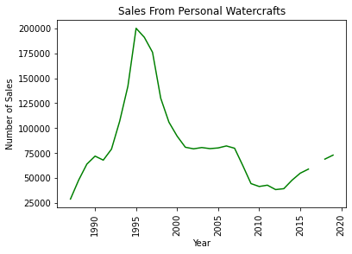
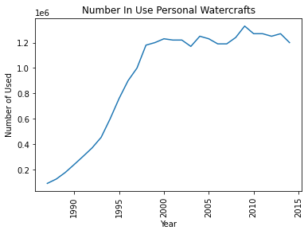
Watercraft Growth

Slide 6
Boat Safety
Increased new boaters creating issues
Deaths, Injuries, and Accidents on the rise
Irresponsible boating practices

Slide 7
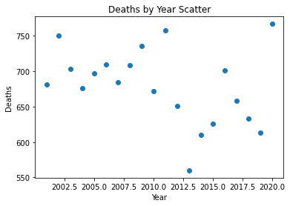
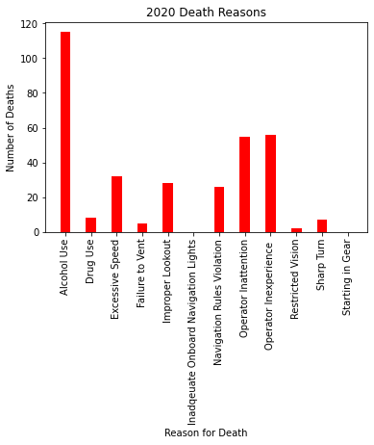
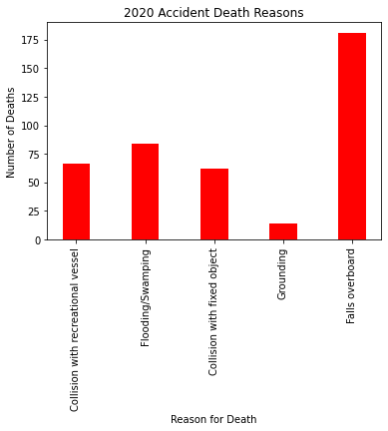
Deaths

Slide 8
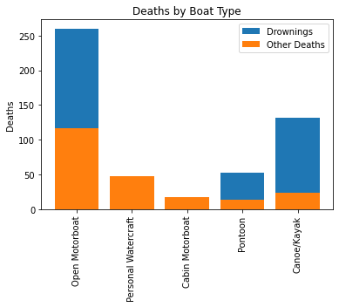
Deaths

Slide 9
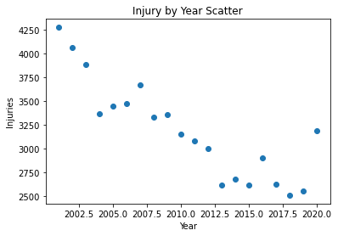
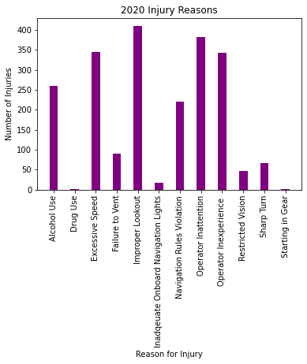
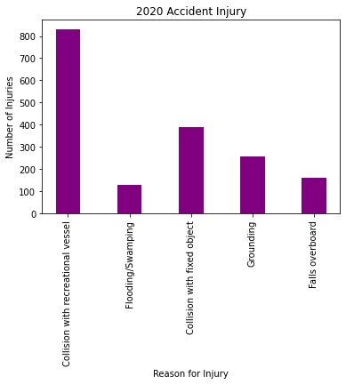
Injuries

Slide 10
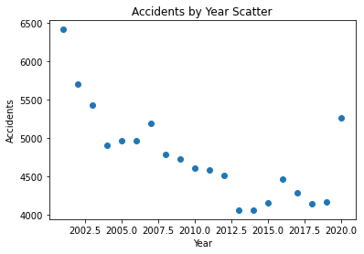
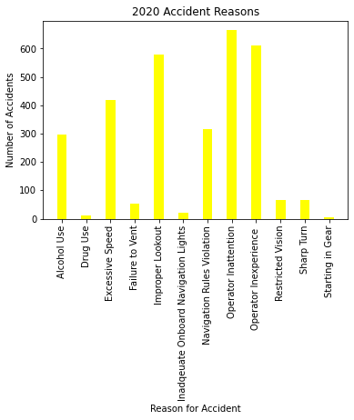
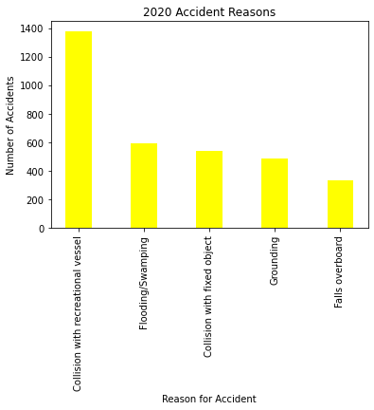
Accidents

Slide 11
Watercraft Safety
Watercrafts are a growing form of entertainment
They have also increased significantly due to COVID
Watercraft usage tends to continue irresponsible actions

Slide 12
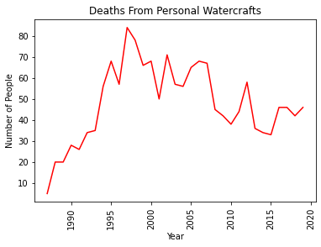
Deaths

Slide 13
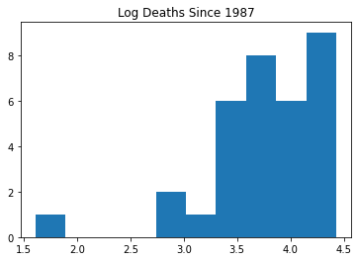
Deaths

Slide 14
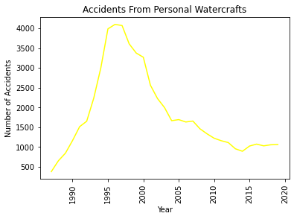
Accidents

Slide 15
Results
If used properly both are safe
We have seen a decline in all the categories
However, COIVD-19 caused an increased surge
We can see in fact boating and water vehicles are safe

Slide 16
Questions
Do you believe boating is safe?
What is the difference between cruises, yachts, and personal boats?
Should you use an experience captain?
What are the major causes of accidents?
Should individuals be allowed to own boats?
Difference between boats and watercrafts?
Who is to blame for accidents?
Do you have concerns about increased growth in the market?
How do boats compare to other recreational motor vehicles?
Why are boating deaths so highly covered?

Slide 17
Thank You!

Slide 18
References
Curt Brown, The Herald News. (2020, July 26). The perfect storm: Lots of boats, lots of inexperience, lots of accidents. The Herald News. https://eu.heraldnews.com/story/news/accident/2020/07/26/perfect-storm-lots-of-boats-lots-of-inexperience-lots-of-accidents/42908611/
Hyde, D. (2017, March 17). Sun Sentinel. Sun Sentinel. https://www.tribpub.com/gdpr/sun-sentinel.com/
MAYBERG. (2021, May 14). Boating accidents increase statewide; Lee ranked fifth. Captivasanibel.Com/. https://www.captivasanibel.com/2021/05/14/boating-accidents-increase-statewide-lee-ranked-fifth/#:%7E:text=The%20Florida%20Fish%20and%20Wildlife,their%20lives%20in%20boating%20accidents.
Personal Watercraft Safety Data. (2020). Bureau of Transportation Statistics. https://www.bts.gov/content/personal-watercraft-safety-data
Rubin, C. (2020, July 2). The Boat Business Is Booming. The New York Times. https://www.nytimes.com/2020/07/02/style/boat-sales-summer.html
Safe Boating Tips. (n.d.). Discover Boating. Retrieved July 29, 2021, from https://www.discoverboating.com/ownership/safety/tips
Sullivan, S. (2019, January 16). Are Boats Safer Than Airplanes & Cars? (Helpful Facts). Godownsize. https://www.godownsize.com/boat-safety-compared-airplanes-cars/#:%7E:text=Are%20Boats%20Safer%20Than%20Airplanes%20And%20Cars%3F,road%20accidents%20per%20year%20globally.
Three of the Most Dangerous Boating Conditions. (n.d.). Travelers Insurance. Retrieved July 29, 2021, from https://www.travelers.com/resources/boating/three-of-the-most-dangerous-boating-conditions
U.S. Boat Sales Reached 13-Year High in 2020, Recreational Boating Boom to Continue through 2021. (2021, January 6). Nmma. https://www.nmma.org/press/article/23527
uscgboating. (2020). Uscgboating. https://www.uscgboating.org/library/accident-statistics/Recreational-Boating-Statistics-2020.pdf

